Slide 1

Your Personal Health Map

Slide 2
TABLE OF CONTENTS
01
04
02
05
03
Introduction
Solutions
What is Mediline?
Solutions to the mentioned problems
Existing Problems
Expected Results
Various real-life problems which we have seen
Expected changes
Prototype
Basic UI of the application

Slide 3
INTRODUCTION
INTRODUCTION
MEDiLINE is a one-stop solution to all the medical services related problems,either you need an appointment,some daily checkups,medicines etc..it will be 24/7 available for all our needs.

Slide 4
PROBLEMS
Price comparing in aspects of lab tests or consultation fees
Whenever we need to check the prices of lab tests ,we need to check one by one on internet which becomes very cumbersome.
Appointments
By now, we all face problems in booking the appointments,most of the hospitals don’t book online so patients need to come there which creates rush.
Beds availability
During the need of hospital beds there is no any specific place for all to see that how many beds are available.

Slide 5
PROBLEMS
Private clinics
Not all the patients go to the hospitals only, there are lots of private clinics of the doctors, need to search one by one their addresses availability etc..
Emergency services
At the time of urgency , its become very difficult to call nearby ambulance..sometimes due to the delay situation becomes uncontrollable
Maintaining bills,lab-reports
Handling of all the pharmacy bills,records,lab-reports especially in long-term tedious becomes tedious for all of us.

Slide 6
One major problem
PROBLEMS
So one major problem which I have seen is that most old age people need to repeat their medicines every 1 or 2 months., due to this, they need to stand in the queues for the same written prescription medicines, get copies from the doctors and then get the same medicines which is very tiring for them.

Slide 7

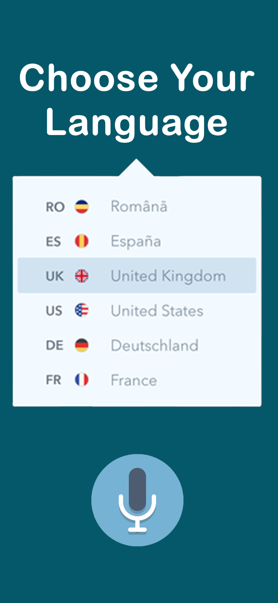
PROTOTYPE
So, here we have MEDiLINE the one stop solution for all the medical related services
LANGUAGE
SELECTION SCREEN
(ONE TIME)
LOADING SCREEN

Slide 8
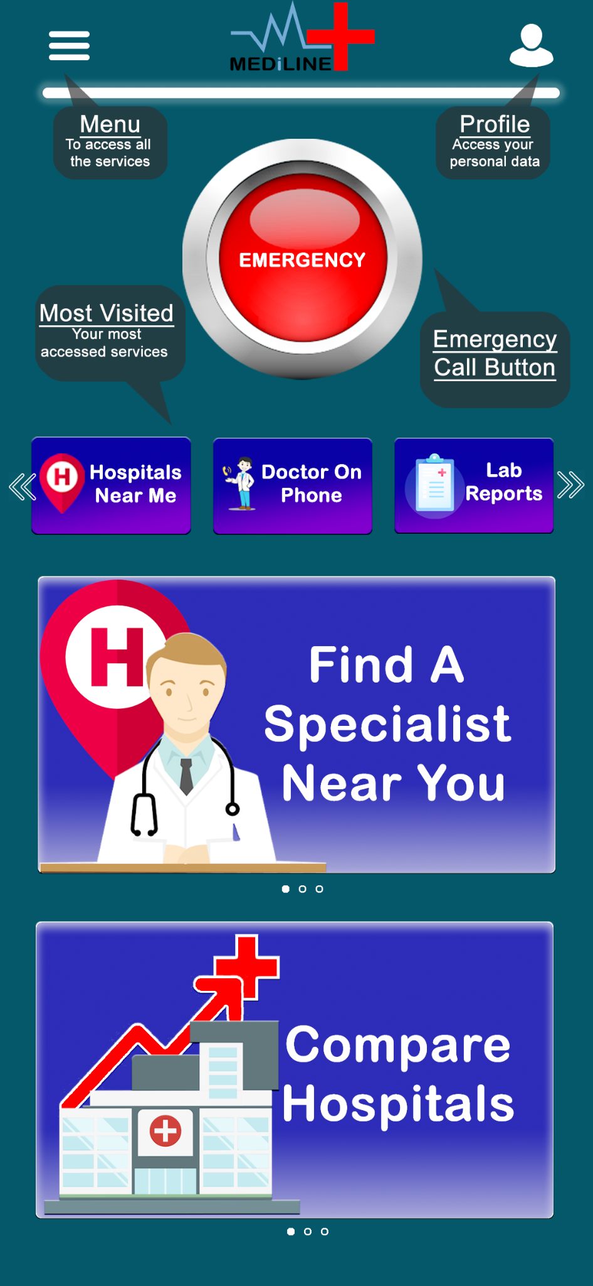
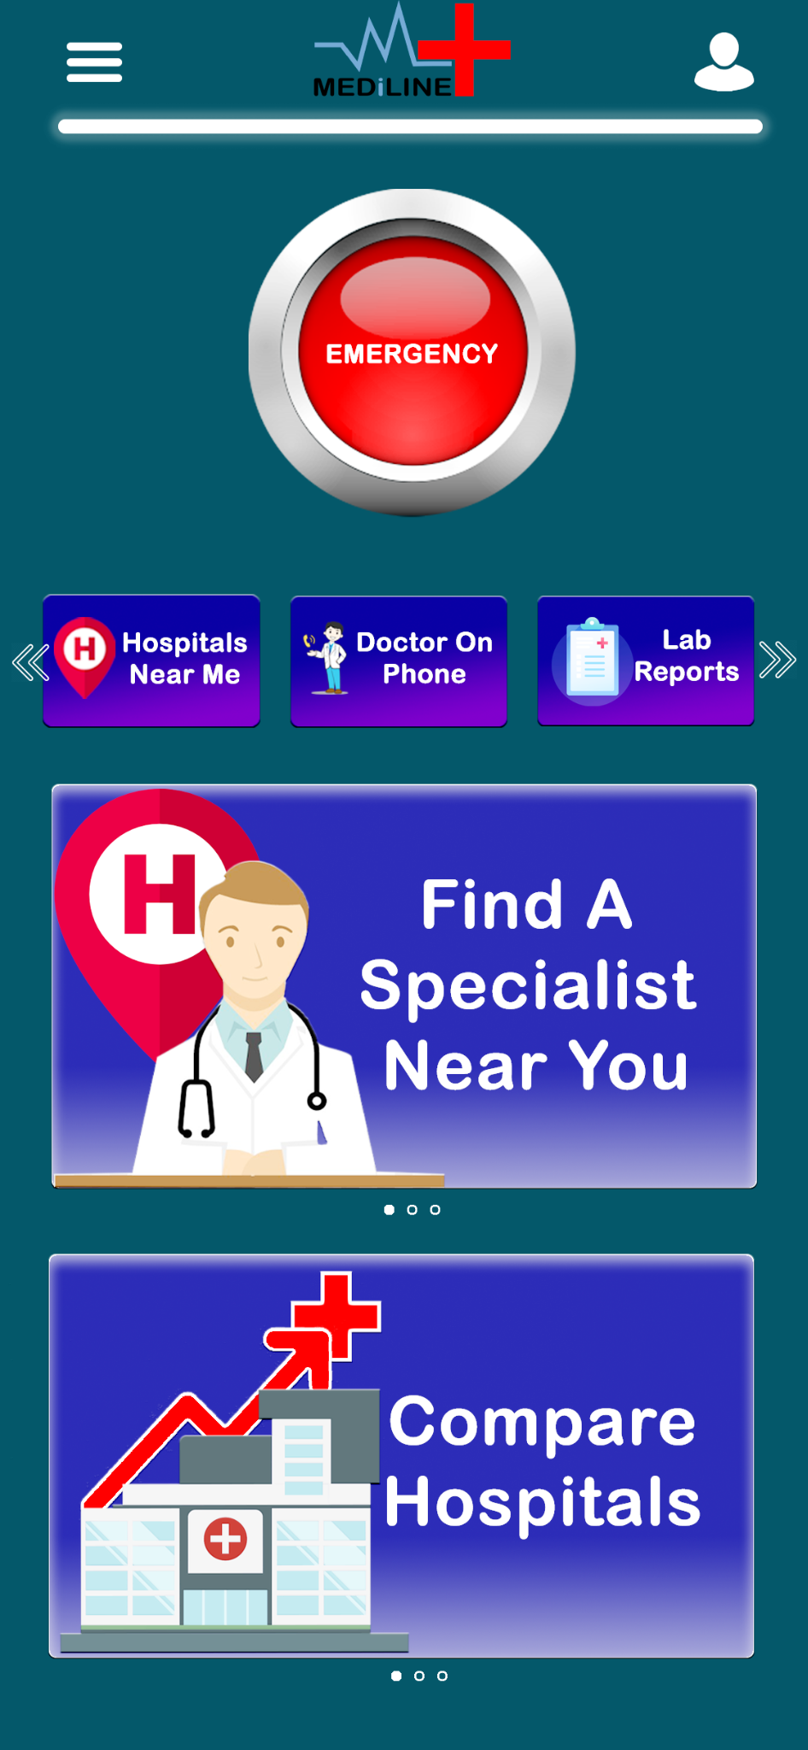
PROTOTYPE
GUIDED NAVIGATION
WELCOME SCREEN IN THE LANGUAGE SELECTED EARLIER
(ONE TIME)
DASHBOARD
(MAIN PAGE)

Slide 9
PROTOTYPE
HAMBURGER ICON FOR MENU
PROFILE
ACCESS PROFILE
ACCESS LAB REPORTS
ORDER MEDICINES
SET TIME PERIOD FOR SELF ORDER OF MEDICINES
SET REMINDERS FOR APPOINTMENT
SELF EXAMINATION
EMERGENCY CALL
BUTTON
MOST ACCESSED SERVICES
QUICK ACCESS CAROUSELS

Slide 10
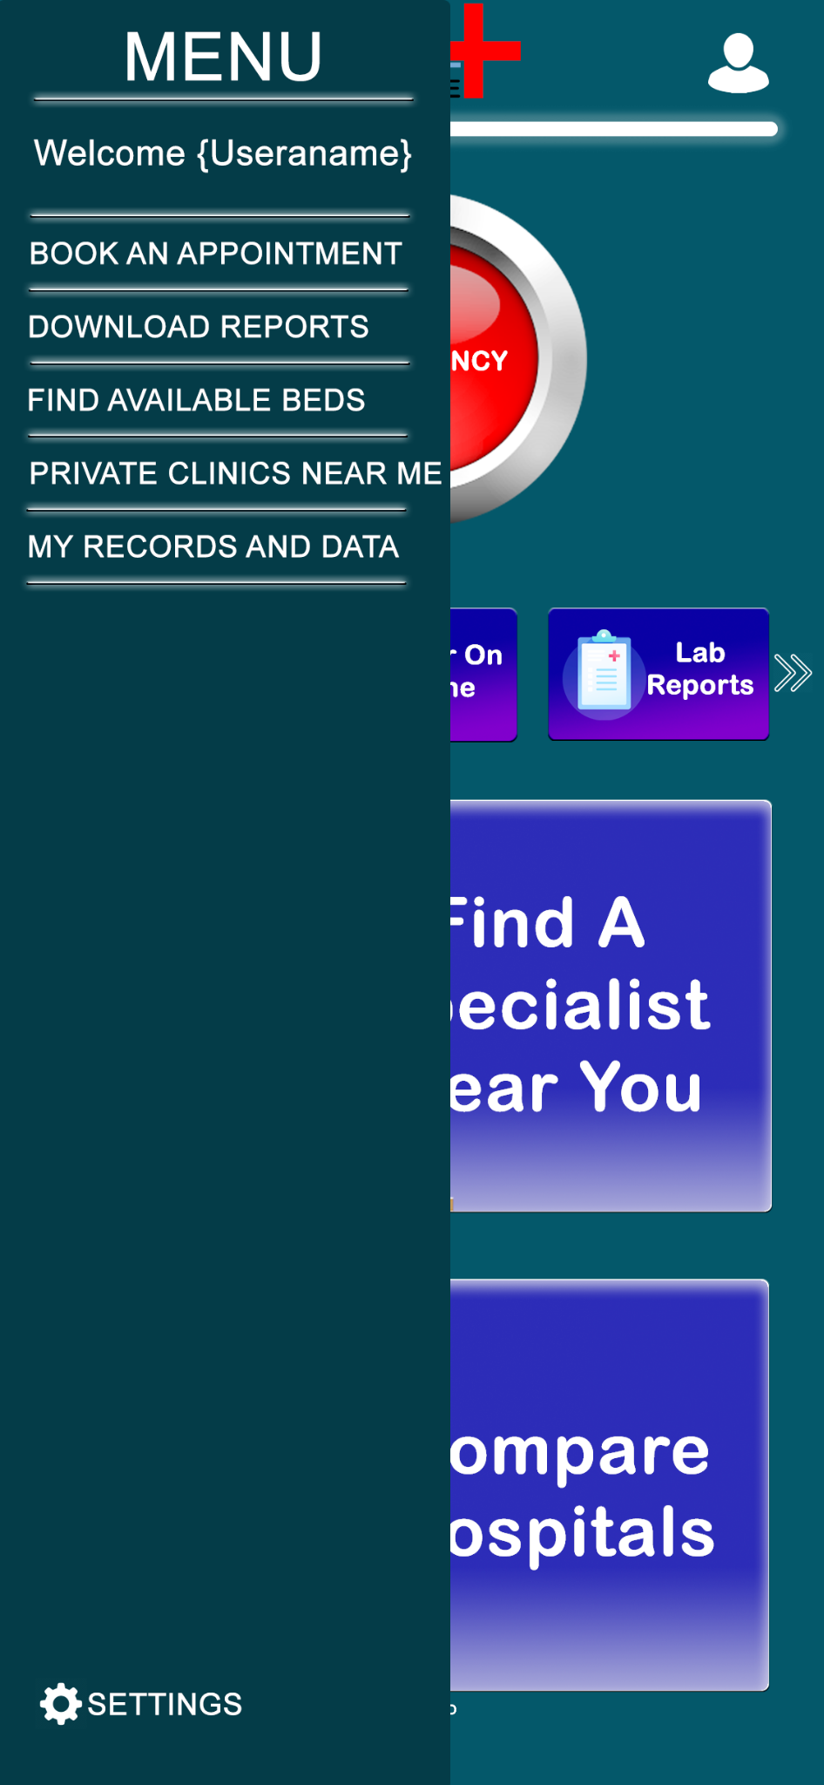
PROTOTYPE
ONCE YOU CLICK THE HAMBURGER ICON THE MENU PANE APPEARS
NAME OF THE USER
BOOK AN APPOINTMENT
This button guides you to book an
appointment online
DOWNLOAD REPORTS
This button guides you to download
your lab test reports and from the comfort of your home
FIND AVAILABLE BEDS
This button guides you to search for
beds available in your nearby hospitals
PRIVATE CLINICS NEAR ME
This button guides you to search all the
private clinics near your current location
MY RECORDS AND DATA
This button guides you to search all
your previous visits, prescriptions, lab reports etc.
SETTINGS

Slide 11
SOLUTIONS
Emergency button on the top
There will be one emergency button on the top through which the gps location will be find and nearby ambulance will connect with the patient
Appointments and doctor’s information
Patients will get the entire information either it is about appointment or they will also be able to check the doctors on the basis of their speciality
Online delivery of reports/medicines
In case the old patients or anyone need the same repeated medicines online delivery would be there ,likewise for the reports also

Slide 12
SOLUTIONS
Maintaining records of bills,reports
Separate pdf files including bills,lab-reports
For easier access anytime or anywhere
Beds availability
Separate sections to check the availability of beds to avoid unnecessary mess inside the hospital
Private clinics
Information about the private clinics ,their addresses,slot booking,video call option will be provided

Slide 13
PATIENT MEDICAL HISTORY
AGE: 25
GENDER: Female
ALLERGIES: None
LOCATION: Jaipur,Rajasthan
ENT problems ,patient has consulted with Dr.Suresh gupta and description of diseases
Consulted with Dr.Neerja sharma regarding neurological disease
Consulted with Dr.Anjali gupta regarding physiotherapy
2005
2008
2014

Slide 14
EXPECTED CHANGES
01
02
Easy access will be there for all the age groups.Connectivity would be there between hospitals ,laboratories,private clinics and their respective information about locations
Mainly, the rush and the non-systematic system will become quite systematic by this , small laboratories and hospitals will also get a chance to get identified.

Slide 15
THANKYOU
Made By:
Lata Asnani 2010993705 (Leader)
Ashwin Kumar 2010993739
Parukh Goyal 2010993741

